Slide 1
JS Training JS is not perfect but works
Krzysztof Danielewicz

Slide 2
Agenda
Best practices
JS similar and different to modern languages (scopes, closure, hoisting)
Objective JS: obj literal, prototype, module pattern
ECMA5 array functions, strict mode,
Future and necessary fixes
ECMA2015
TypeScript

Slide 3
About me
.net developer with 7 year experience
Expertise in Front-end technologies: JS, angularJS, CSS
Current assignment Total Cost of Ownership for Volvo Penta
Offline web app using Application Cache
AngularJS
The app estimates maintenance cost of Volvo Penta engines.

Slide 4

Scopes

Slide 5
JavaScript scopes
Syntax is similar to C syntax languages (Java, C#) there are parentheses for begin and end block statements like i.e.: for, if and function.
All block statements apart from “function” have different behaviour to the modern languages. They do NOT create local scopes with var statement.

Slide 6

“for” doesn’t create a scope
var temp = 'outer';
for (…) {
var temp = 'inner';
}
console.log(temp); // inner

Slide 7
“function” create a scope
var temp = 'outer';
function f1(){
var temp = 'inner';
}
f1();
console.log(temp); // outer
Img= superman

Slide 8
JS safe scope
ECMA2015 introduces let and const keywords which create scopes for every block statements.

Slide 9
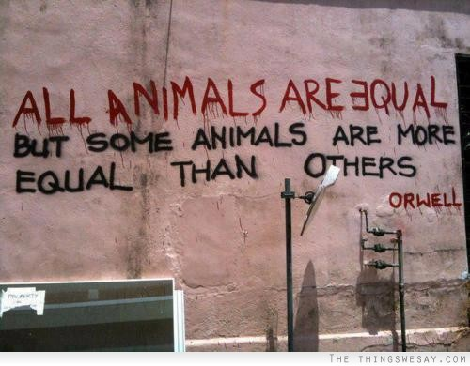

Slide 10
JavaScript – operators
JS syntax is similar to C syntax languages (Java, C#).
The same operators ==, !=, + different behaviour.
Operators: ==, !=, +, - invokes conversions before comparison.
Unexpected behaviour:
'foo' + false // "foofalse”
0 == false // true
'1' == 1 // true
Use operators ===, !== which check types and do explicit comparision.

Slide 11

Hoisting

Slide 12
Hoisting
JavaScript mechanism where variables and function declarations are moved to the top of their scope before code execution.

Slide 13

Clousure

Slide 14
Clousure
In C# takes the form of an in-line delegate/anonymous method/lambda. A closure is attached to its parent method meaning that variables defined in parent's method body can be referenced from within the anonymous method.
Example from c#, with action called inside for and after end of for

